Slide 1
UNIVERSIDAD DE LAS FUERZAS ARMDAS-ESPE
Responsive Web Design
Name: Natasha criollo

Slide 2
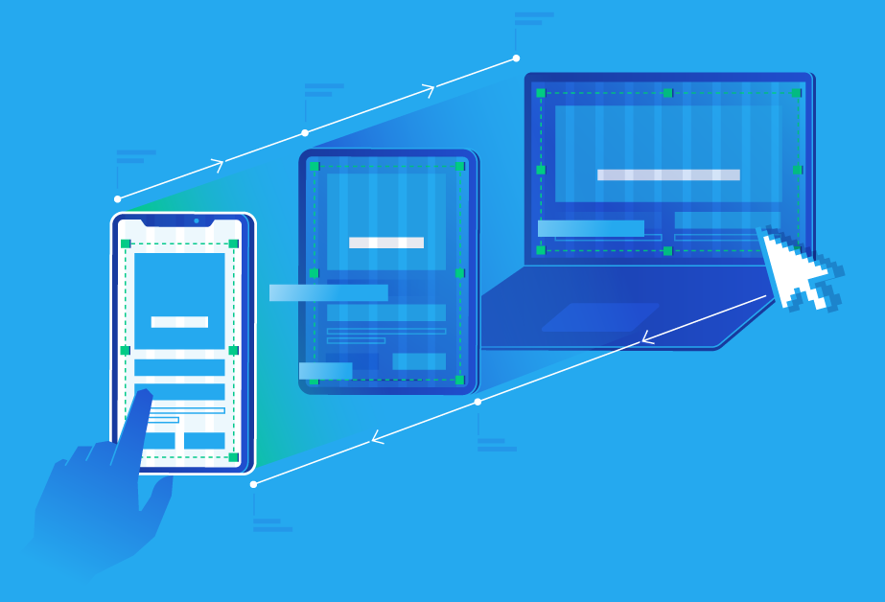
What is responsive design?
Responsive or adaptive web design is a web design technique that seeks the correct display of the same page on different devices. From desktop computers to tablets and mobiles.

Slide 3
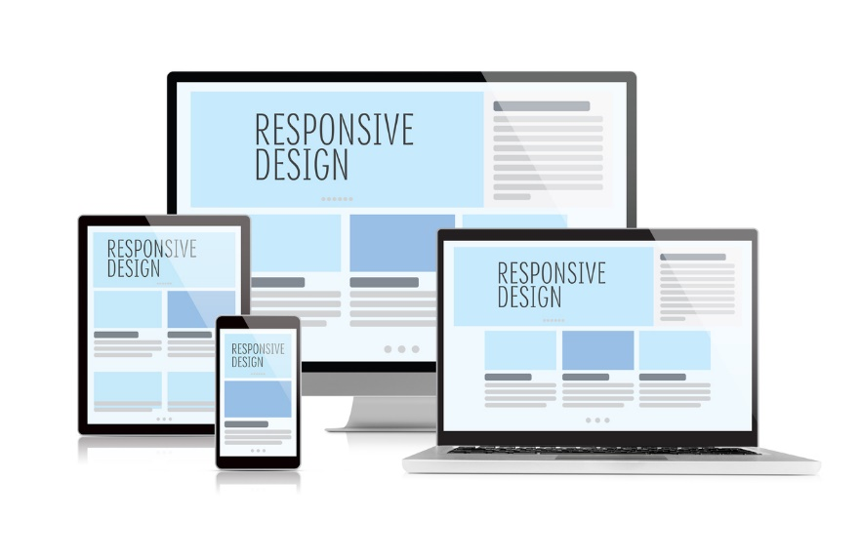
What does responsive design consist of?
It is about resizing and placing the elements of the web so that they adapt to the width of each device, allowing a correct visualization and a better user experience. It is characterized because the layouts (content) and images are fluid and CSS3 media-queries code is used.
Responsive design allows development time to be reduced, avoids duplicate content, and increases the virality of content as it allows sharing in a much faster and more natural way.

Slide 4
How to make a responsive web design?
It is possible to create your own responsive website using CSS and HTML. But this would be like taking long roads when a freeway is available. In this case, the highway would be a Content Management System (CMS) or a website builder.
A CMS is software that allows you to build your website without having to know how to code, and that includes knowing how to modify a design to make it responsive. Website builders are similar tools, but they give up some functionality that a CMS offers in exchange for ease of use and lower prices.

